Slide 1
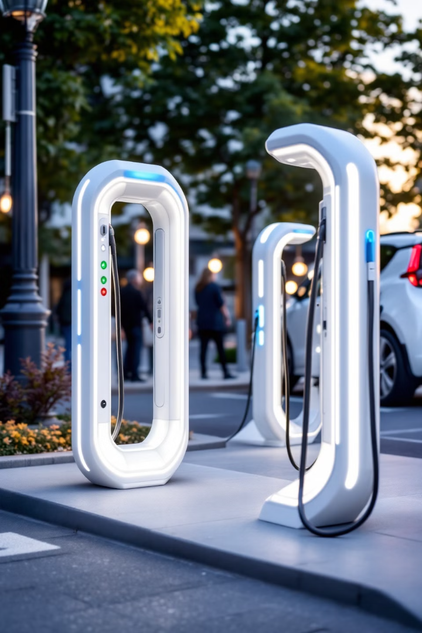
Data Analytics on EV Charging Infrastructure: Trends and Optimization
Welcome to our presentation on Electric Vehicle (EV) Charging Infrastructure. We'll explore current trends, identify optimization opportunities, and provide data-driven insights to shape the future of EV charging networks. Our analysis aims to understand the distribution, accessibility, and efficiency of charging stations, paving the way for strategic infrastructure development.

Slide 2
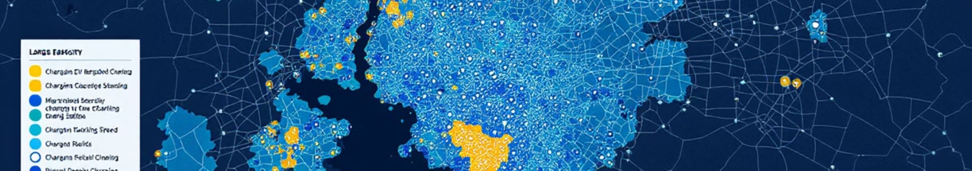
Project Objectives
1
Understand the EV Charging Network
2
Identify Trends
Analyze distribution of charging stations by location, type, and operator. Assess power capacity and connector type availability.
Examine historical trends in charging station installations. Determine popular charging connectors and power levels.
3
Evaluate Accessibility
4
Optimization Opportunities
Map geographic density of charging stations. Identify areas with insufficient infrastructure.
Recommend locations for new charging stations. Optimize connector types based on popularity and power demand.

Slide 3
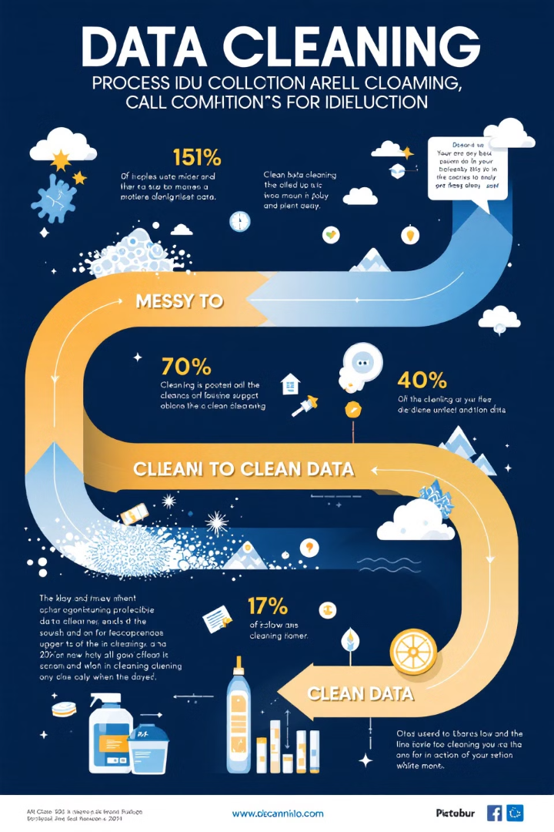




Data Cleaning and Preprocessing
Remove Unnecessary Columns
Eliminate columns like "Unnamed: 0" to streamline the dataset.
Handle Missing Values
Address gaps in data for columns such as steckertypen2–4 and p2_kw–p4_kw.
Convert Date Formats
Transform inbetriebnahmedatum into a proper datetime format for accurate analysis.
Standardize Text Data
Clean and normalize text fields, including city names, for consistency.

Slide 4





Exploratory Data Analysis (EDA)
Descriptive Statistics
Trend Analysis
Generate summary statistics for key metrics like anzahl_ladepunkte and anschlussleistung.
Visualize charging station installation trends over time using line graphs.
Geographic Analysis
Connector Analysis
Map the distribution of charging stations using latitude and longitude coordinates.
Identify most common connector types and their associated power ratings.

Slide 5
In-Depth Analysis
Location Insights
Correlation Analysis
Demand-Supply Gaps
Calculate charging station density per region, considering factors like area and population. This helps identify underserved areas and potential expansion opportunities.
Explore relationships between power capacity and various factors such as station type, operator, or region. This can reveal patterns in infrastructure deployment.
Identify areas with high population but fewer charging stations, highlighting potential markets for infrastructure expansion.

Slide 6
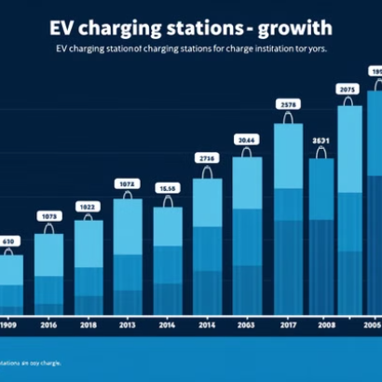
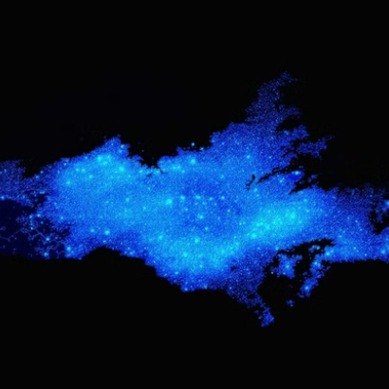
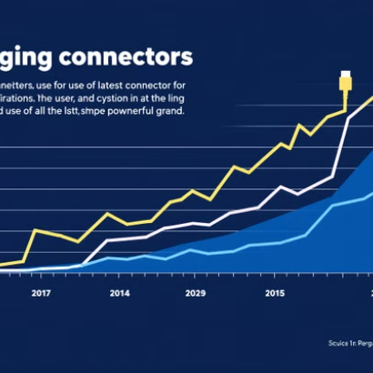
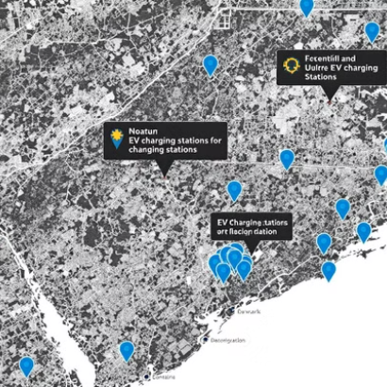
Visualization Techniques

Slide 7

Tools and Libraries
Programming Language
Data Manipulation
Pandas and NumPy for efficient data handling and numerical operations.
Python, chosen for its versatility and robust data analysis capabilities.
Visualization
Geographic Mapping
Matplotlib, Seaborn, and Plotly for creating static and interactive visualizations.
Geopandas and Folium for creating detailed, interactive geographic visualizations.

Slide 8
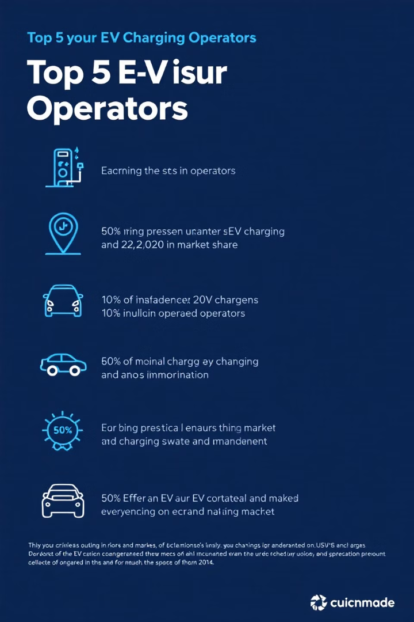
Descriptive Analysis Highlights
1
Top 5 Operators
Identify the leading operators by the number of charging points, providing insights into market dominance.
2
Average Connection Power by City
Calculate and compare the mean connection power across different cities, revealing infrastructure quality variations.
3
Charging Stations per District/City
Count and visualize the distribution of charging stations across different regions, highlighting coverage disparities.

Slide 9
Trend Analysis Insights
Growth Over Time
1
Visualize the year-on-year increase in charging stations, revealing adoption rates and infrastructure expansion.
Connection Power Trends
2
Track changes in average connection power, indicating technological advancements and capacity improvements.
Connector Type Evolution
3
Analyze shifts in popular connector types, guiding future standardization efforts.

Slide 10
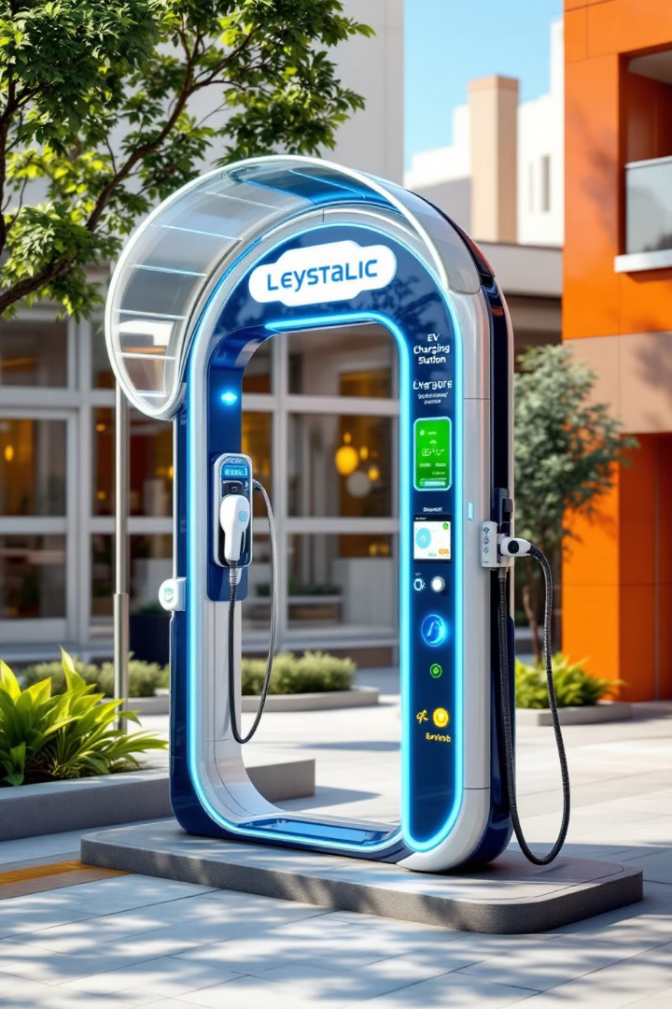
Recommendations and Next Steps
Optimize Station Locations
Standardize Connector Types
Suggest strategic locations for new charging stations based on demand-supply analysis and population density.
Recommend focus on popular connector types to improve compatibility and user experience.
Increase Power Capacity
Continuous Monitoring
Advise on upgrading existing stations and installing high-capacity stations in high-demand areas.
Implement ongoing data collection and analysis to adapt to evolving EV market trends.

